Slide 1
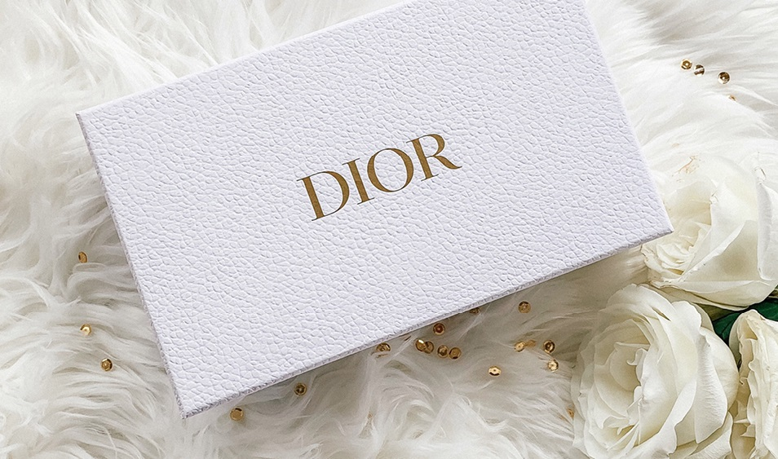
Dior

Slide 2
Table of contents
Endorsement
Branding technique
Stretching & Extension
Different products & branches
Image
What do you think & belive about Dior?
Name & logo
what Dior `s name reprsent?
introduction
What is Dior & how it started?

Slide 3

What is Dior?
1

Slide 4
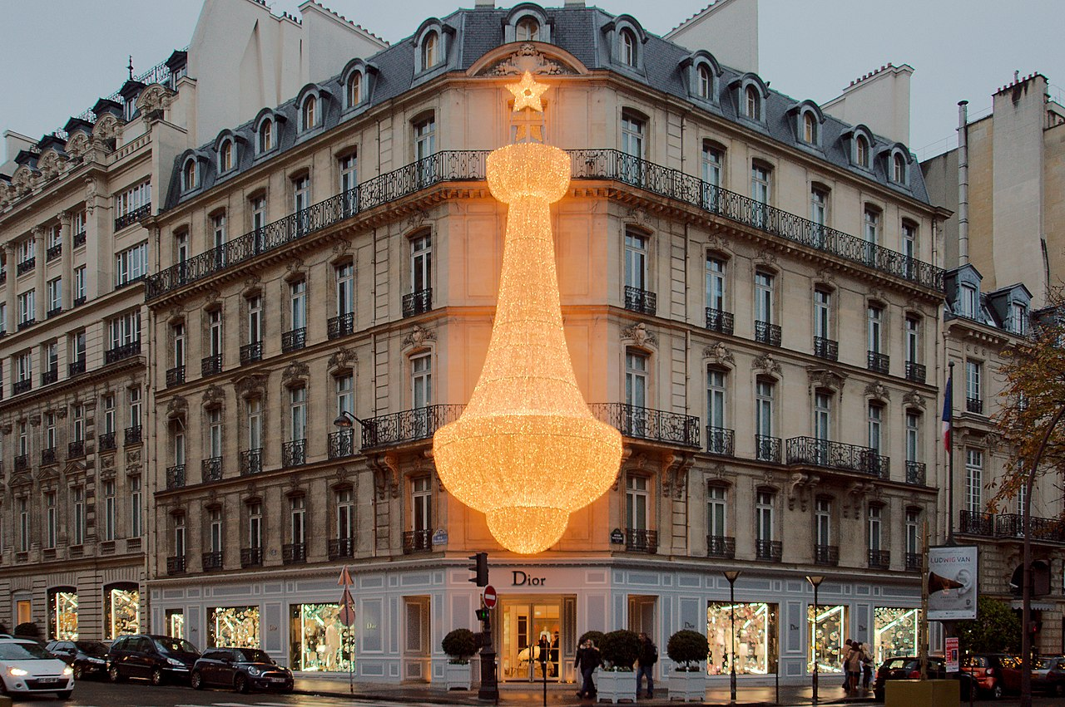
Dior
Dior is a luxury fashion house
The company was founded in 1946 by French fashion designer “Christian Dior”
Ever since the first show on 12 February 1947 the House has continued to assert its vision through elegant, structured, and infinitely feminine collections.

Slide 5
Name & logo
2

Slide 6
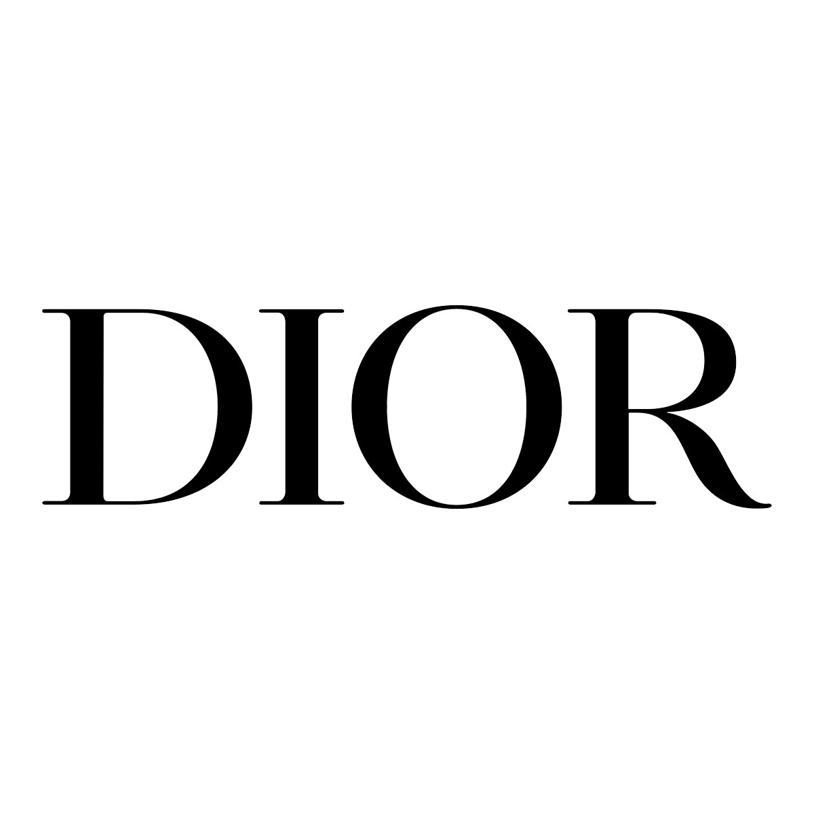

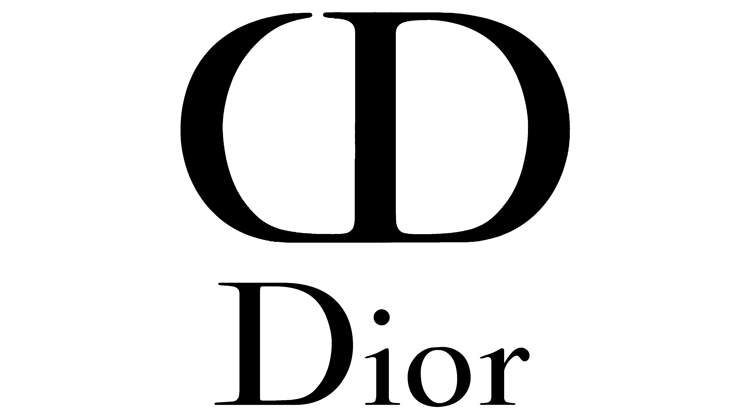
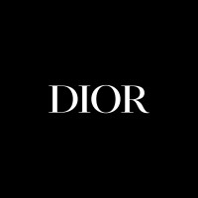
Dior
The logo of the company Dior is the name of the founder and fashion designer of the brand “Christian Dior”.
-Simple and straight forward
-Representative of the personality of its creator
-Black and white

Slide 7
Brand image
3

Slide 8
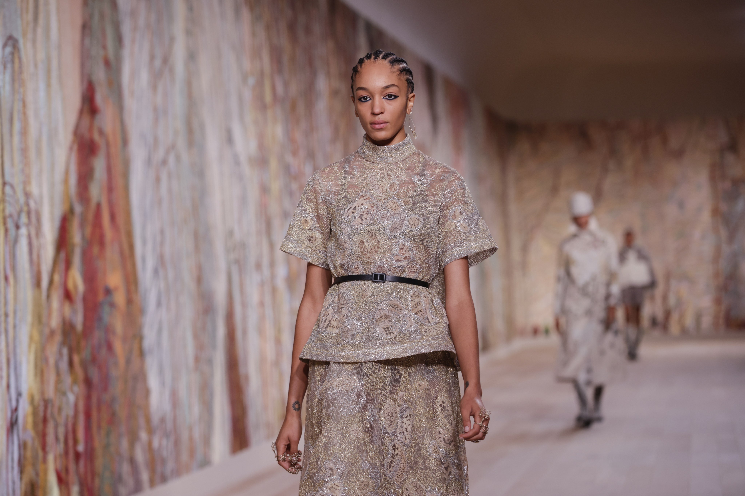
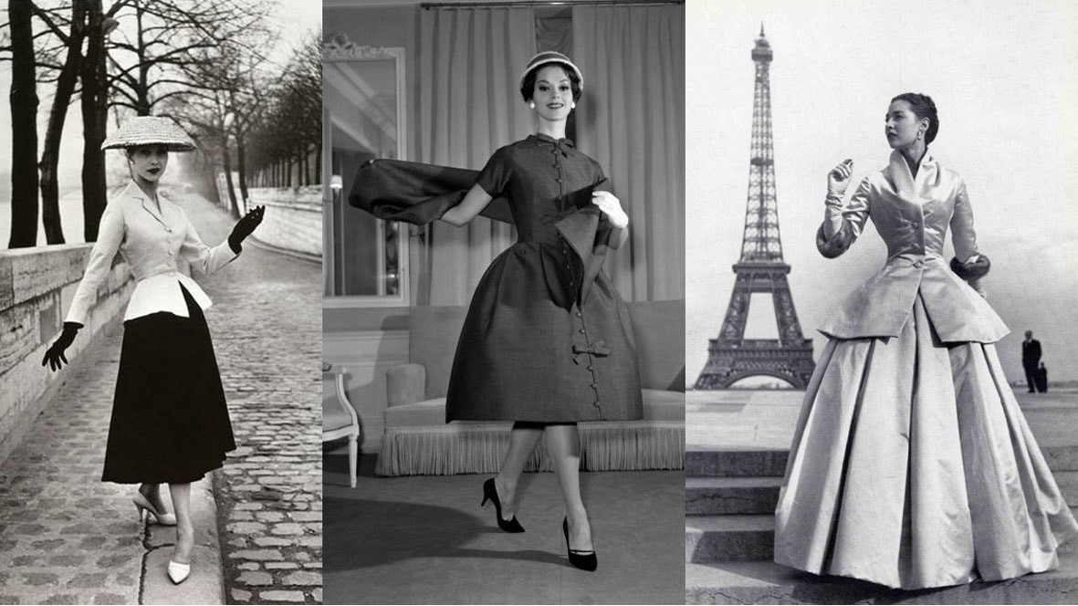
Expensive
Premium
Fashion
Dior
Elegant
French
Proud
High quality fabrics
Trusted

Slide 9
Stretching & Extension
4

Slide 10
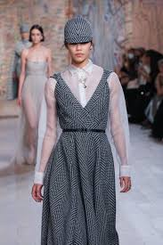
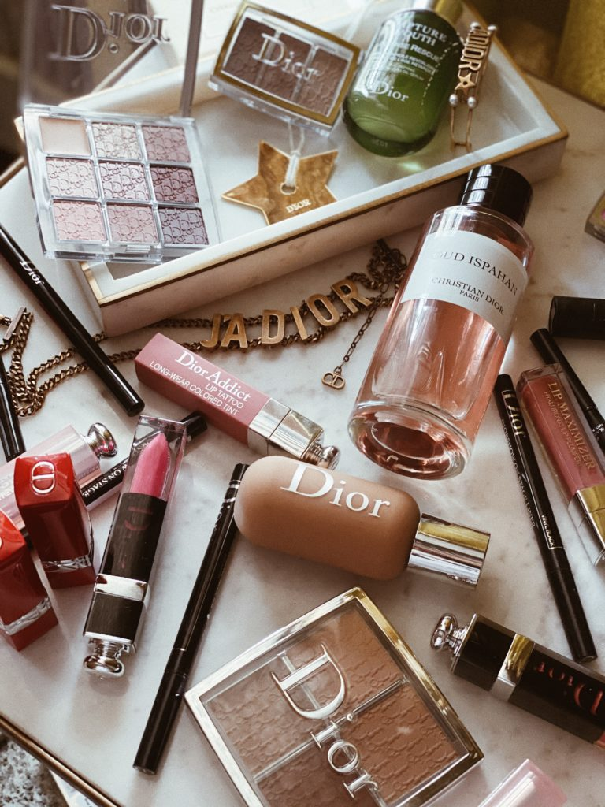
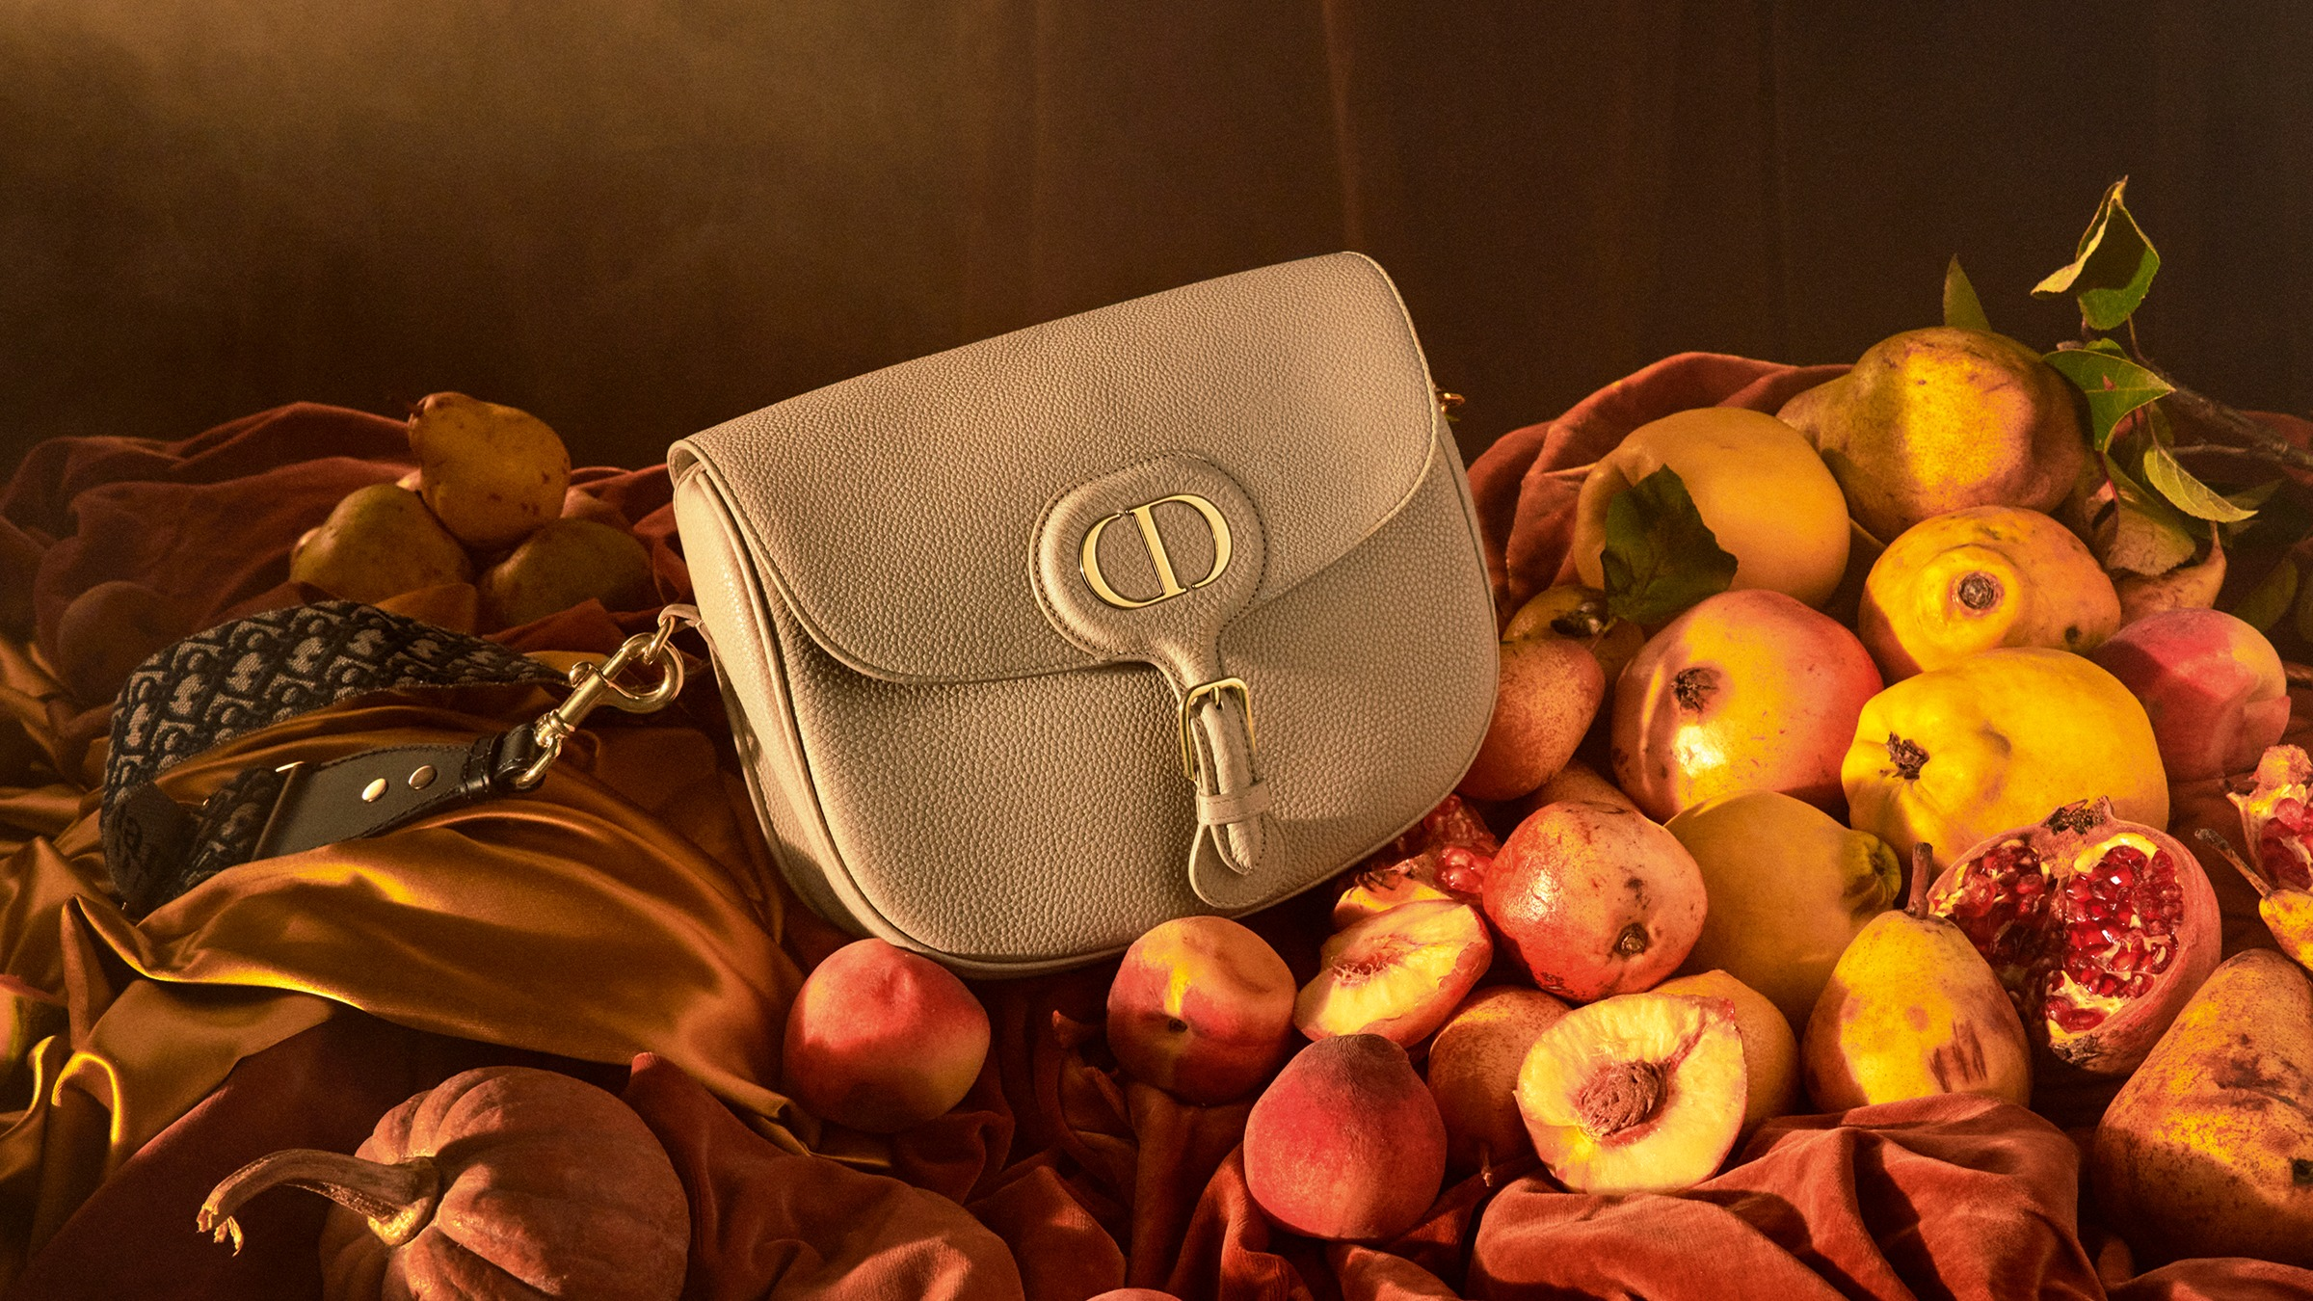
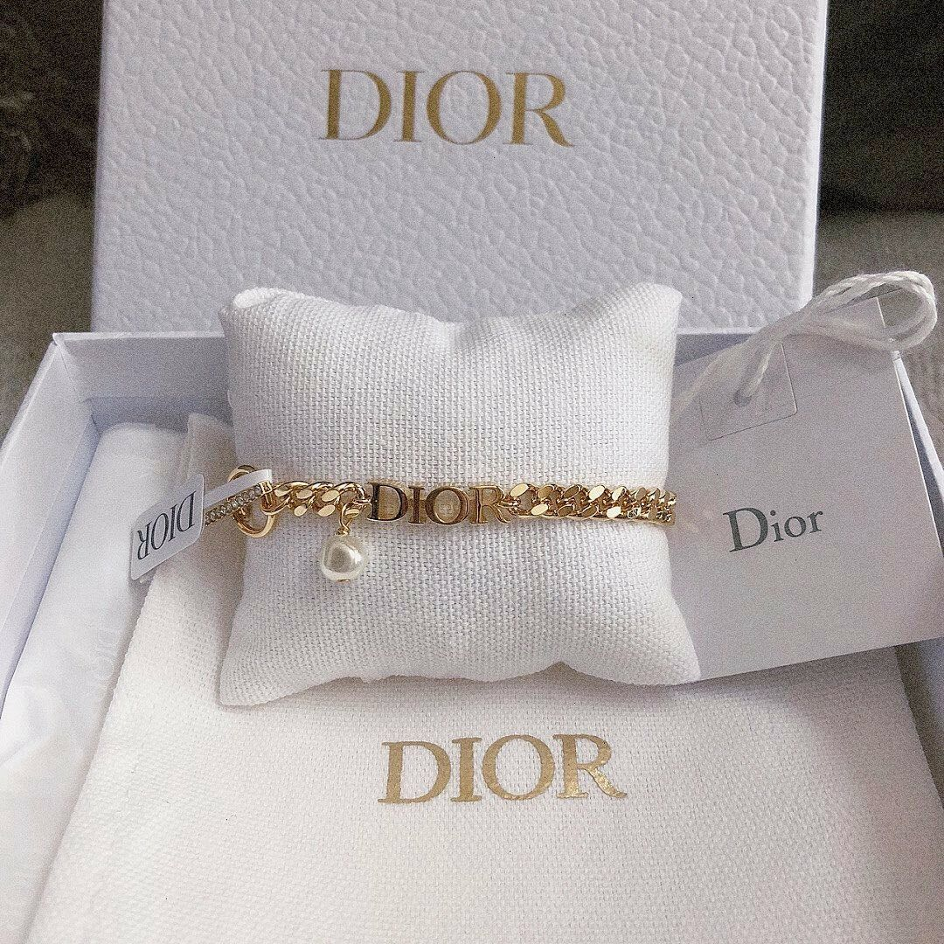
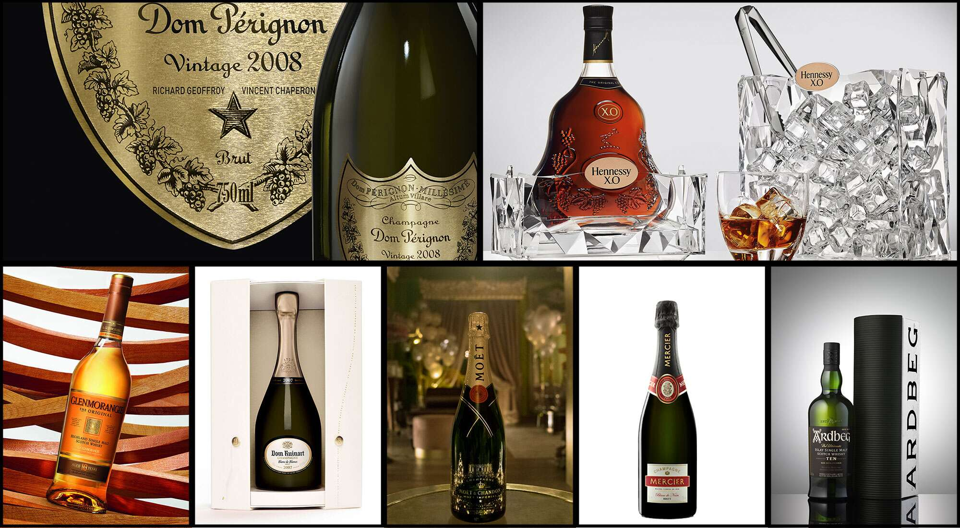
Christian Dior SA offers some products in different categories:
-Christian Dior Couture
-Wines and Spirits
-Fashion and Leather Goods
-Perfumes and Cosmetics
-Watches and Jewelry

Slide 11
number of branches
100
60
40
20
0
Branching
North
America
Africa
Middle
East
Asia
Caribbean
Europe
South
America
Statistics for the month of September 2010

Slide 12
Endorsement
4

Slide 13
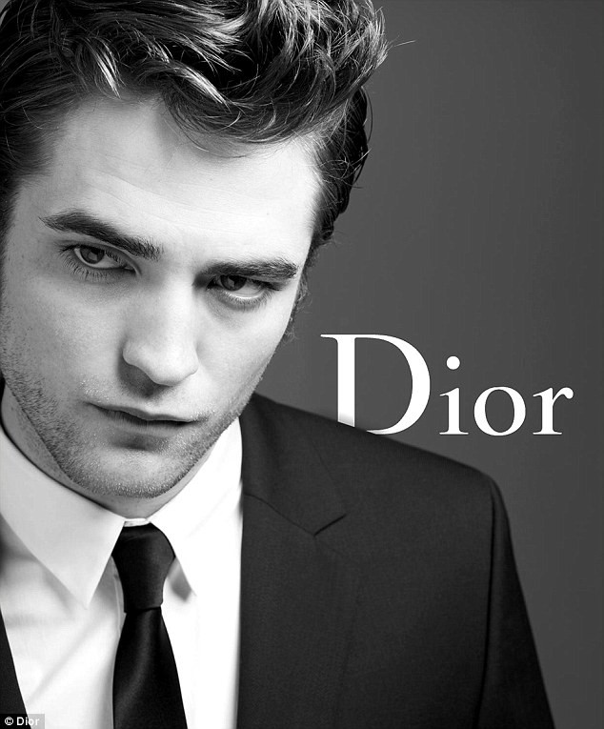
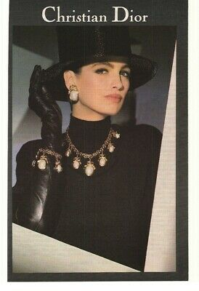
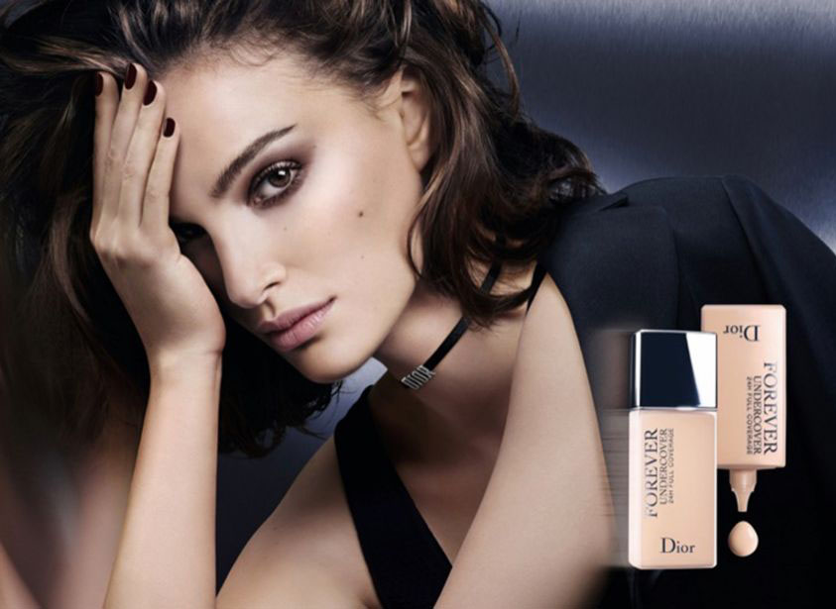
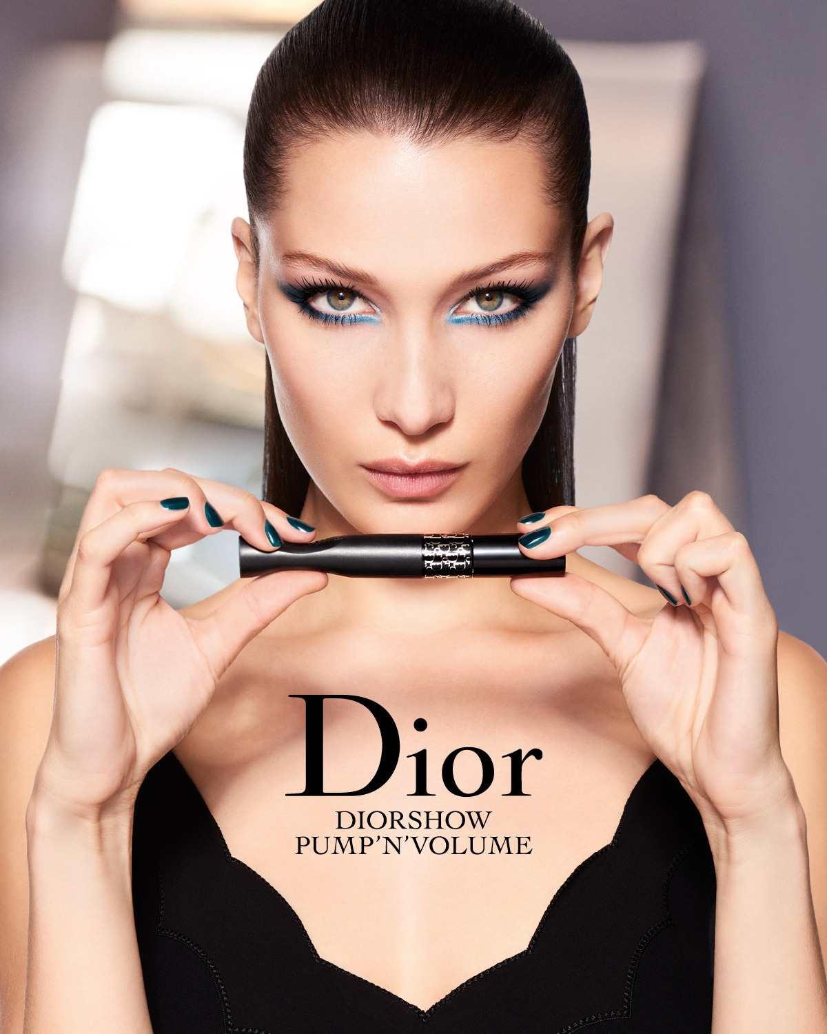
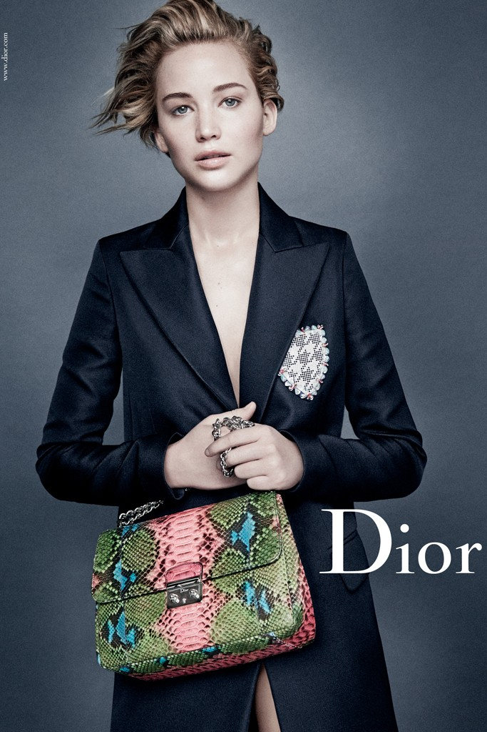
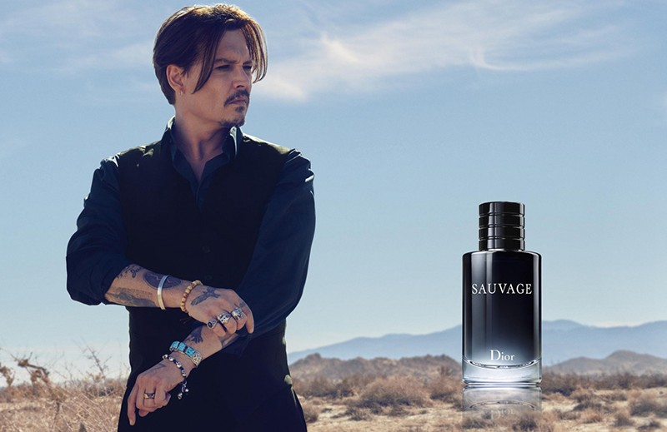
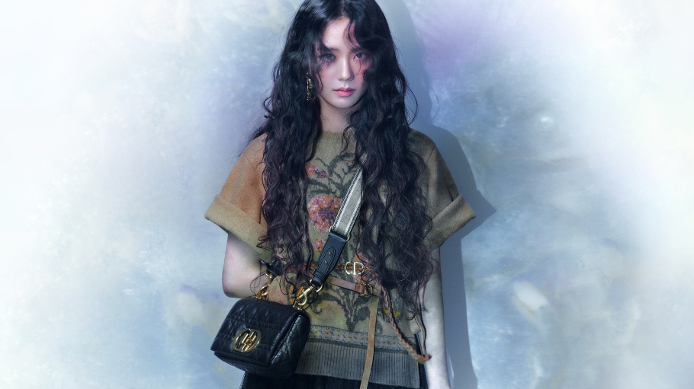

Slide 14
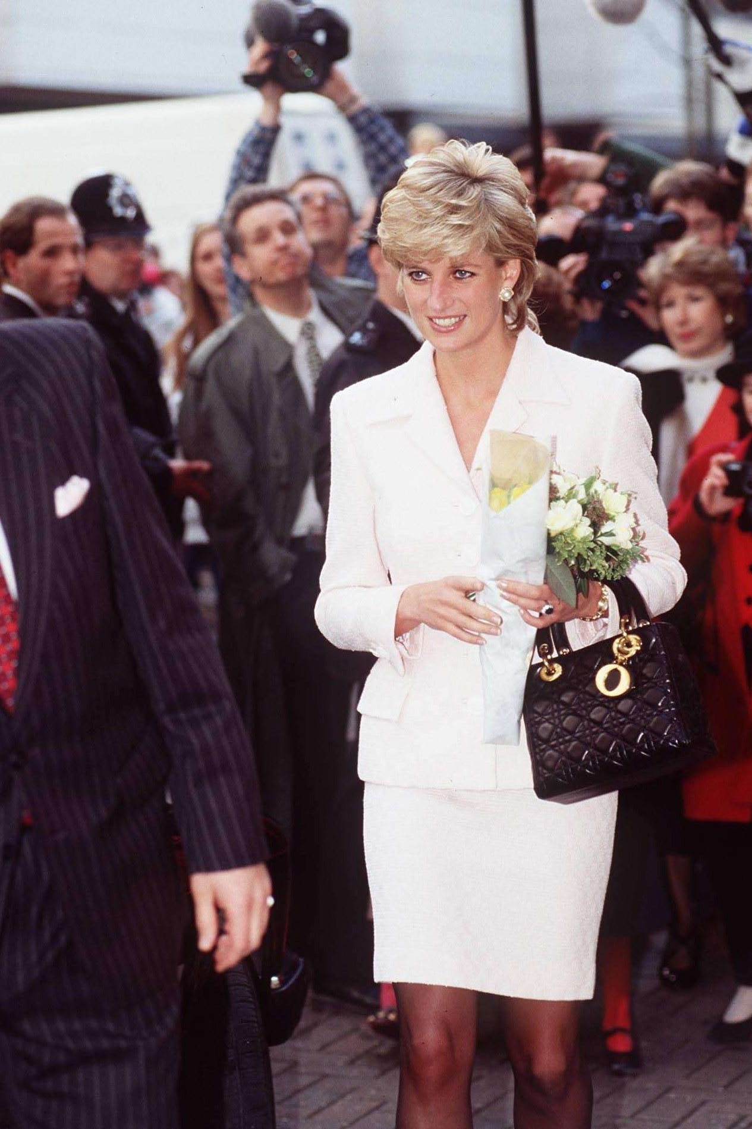
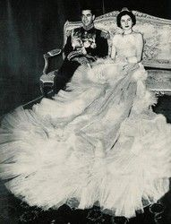
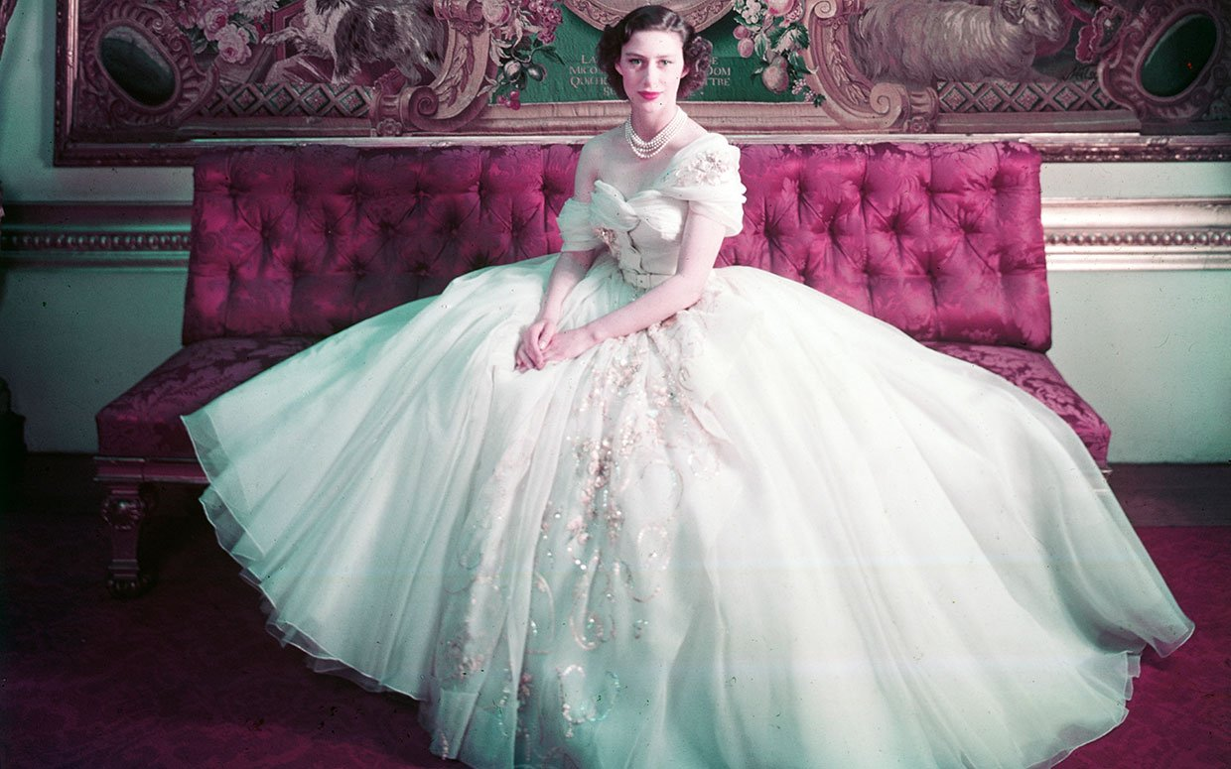
Endorsement
-Princess Diana with the Lady Dior bag made in honor of her
-Princess Margaret wearing her ”favorite dress of all”, made by Christian Dior
-Queen Soraya of Iran in the Christian Dior wedding dress

Slide 15
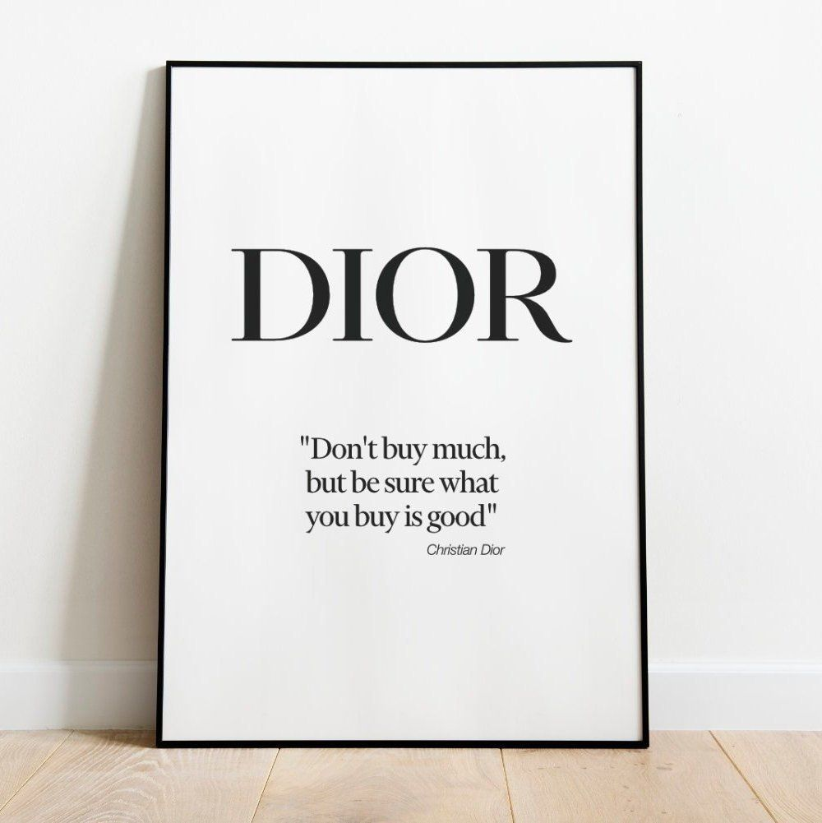
Thanks!

